Slide 1


Slide 2

School of Computing Science and Engineering
Course Code: BCS01T1001 Course Name: Data Analytics (Excel and Tableau)
Unit 3
Exploring Analysis Tool pack
Faculty Name: Dr.L.Godlin Atlas Program Name: B.Tech

Slide 3
Objective
Histogram
Descriptive Statistics
Moving Average
Exponential
Correlation
Regression

Slide 4
Introduction
Descriptive Statistics
Descriptive statistics are used to describe the basic features of the data in a study.
They provide simple summaries about the sample and the measures.
Together with simple graphics analysis, they form the basis of virtually every quantitative analysis of data.

Slide 5
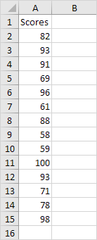
Descriptive Statistics
You can use the Analysis Toolpak add-in to generate descriptive statistics. For example, you may have the scores of 14 participants for a test.

Slide 6
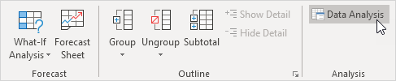
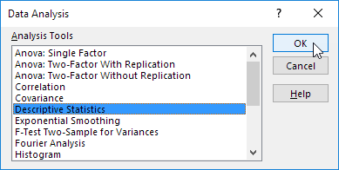
Descriptive Statistics
To generate descriptive statistics for these scores, execute the following steps.
1. On the Data tab, in the Analysis group, click Data Analysis.
2. Select Descriptive Statistics and click OK.

Slide 7
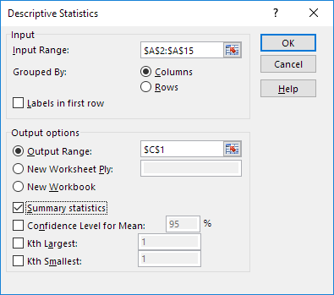
Descriptive Statistics
3. Select the range A2:A15 as the Input Range.
4. Select cell C1 as the Output Range.
5. Make sure Summary statistics is checked.
6. Click OK.

Slide 8
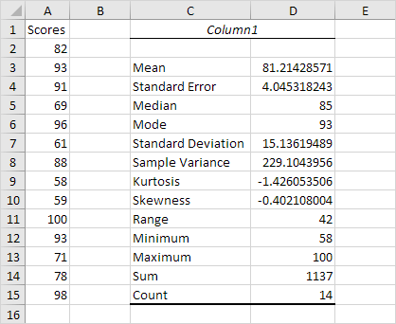
Descriptive Statistics
Result:

Slide 9
References
Books:
1. Microsoft Excel 2013 Step by Step by Curtis D. Frye; Microsoft Press 2013.
2. Learning Tableau by Joshua N. Milligan,ISBN 139781784391164, PACKT Books - Packt Publishing
Reference Books:
Excel: Quick Start Guide from Beginner to Expert, by William Fischer
Web:
1. https://www.excel-easy.com/examples/correlation.html

Slide 10
For Queries Contact
Dr.L.Godlin Atlas
Email Id: godlin.atlas@galgotiasuniversity.edu.in
Whatsapp: 9080806220

Slide 11


